Slide 1
Lecture 13 – Linear Regression
Dr. Sifat Momen

Slide 2
Model Representation
Linear Regression with one variable (i.e. univariate linear regression)

Slide 3
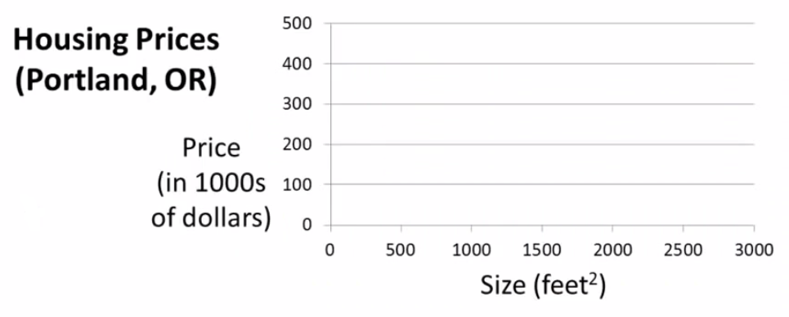


Slide 4
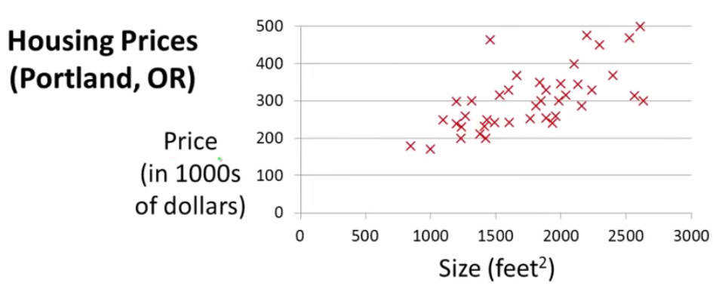

Slide 5
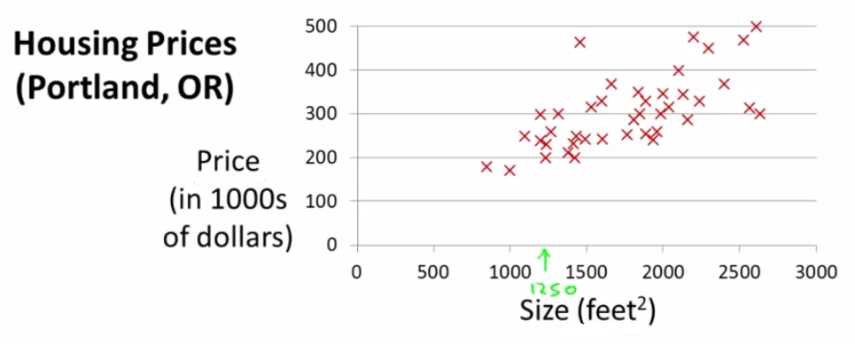

Slide 6
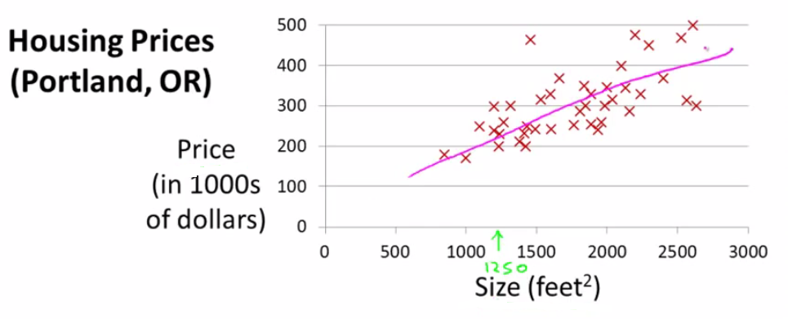

Slide 7
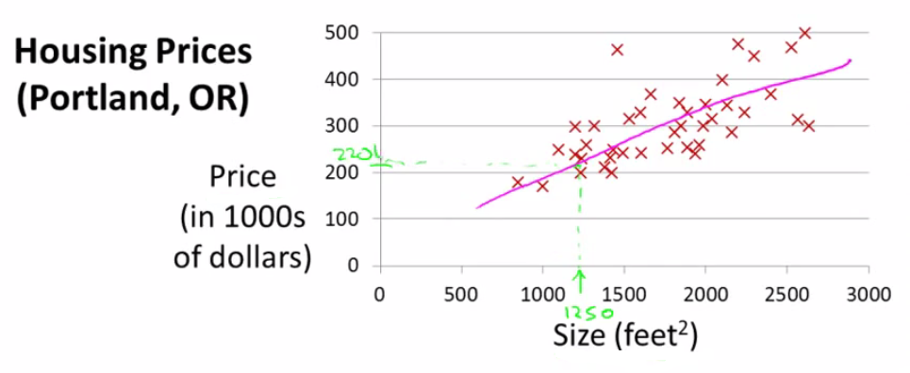

Slide 8
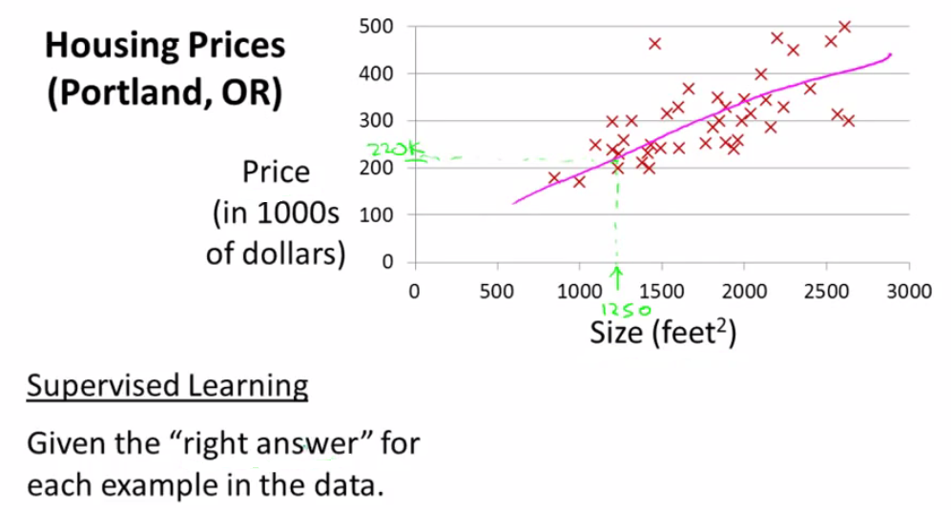

Slide 9
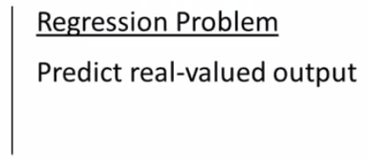

Slide 10
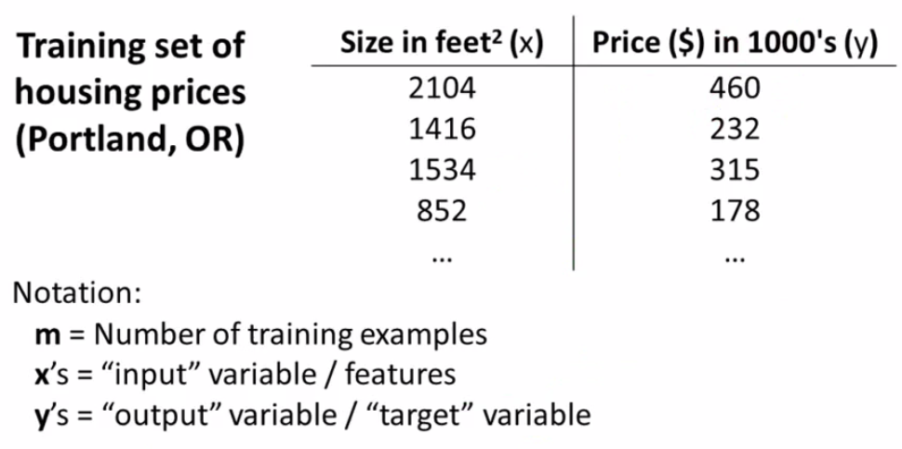

Slide 11

(x, y)= One Training Example
x (i), y (i)= ith Training example
x (1) = 2104
x (2) = 1416
y (1) = 460
Y (2) = 232

Slide 12

Training Set
How do we represent h ?
Learning Algorithm
Size of house
h
Estimated price
Linear regression with one variable.
Univariate linear regression.

Slide 13

Cost function
Linear regression with one variable
Machine Learning

Slide 14
A cost function lets us figure out how to fit the best straight line to our data.

Slide 15
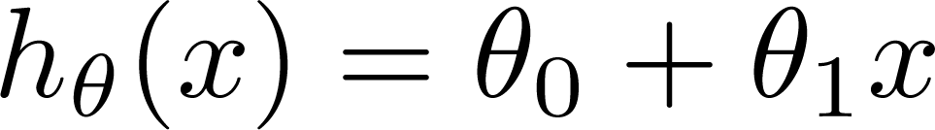

Training Set
Size in feet² (x) | Price ($) in 1000's (y)
2104 | 460
1416 | 232
1534 | 315
852 | 178
… | …
Hypothesis:
‘s: Parameters
How to choose ‘s ?

Slide 16
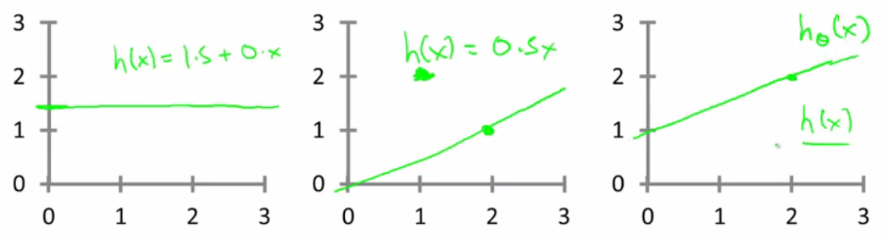
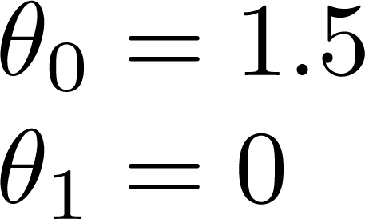
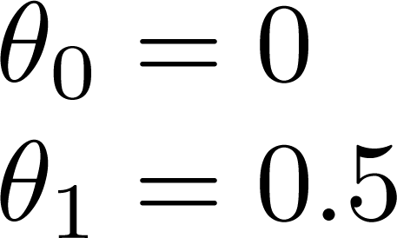
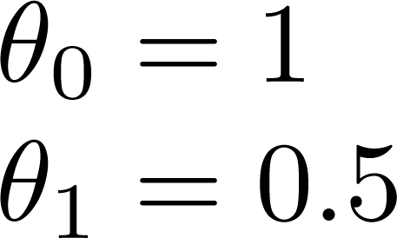

Slide 17

Minimizing θ₀/θ₁ means we get the values of θ₀ and θ₁ which find on average the minimal deviation of x from y when we use those parameters in our hypothesis function
More cleanly, this is a cost function

Slide 18
So to recap
Hypothesis - is like your prediction machine, throw in an x value, get a putative y value.
Cost - is a way to, using your training data, determine values for your θ values which make the hypothesis as accurate as possible
This cost function is also called the squared error cost function.
This cost function is reasonable choice for most regression functions.
Probably most commonly used function.
In case J(θ₀,θ₁) is a bit abstract, going into what it does, why it works and how we use it.

Slide 19
Cost function intuition I
Linear regression with one variable
Machine Learning

Slide 20
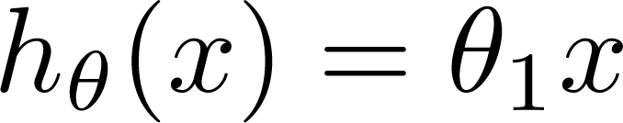
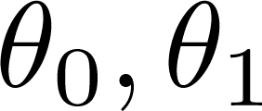

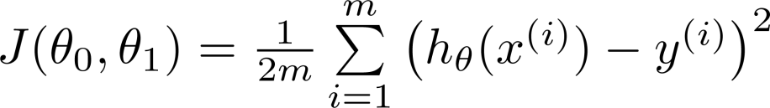
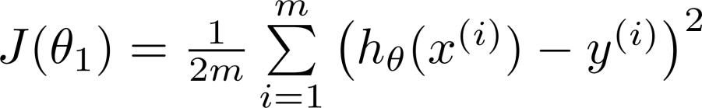
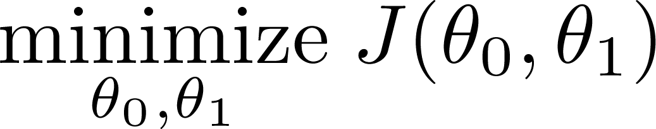
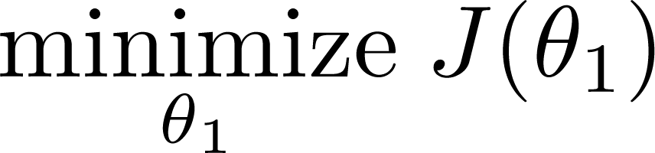
Simplified
Hypothesis:
Parameters:
Cost Function:
Goal:

Slide 21
Lets consider some intuition about the cost function and why we want to use it
The cost function determines parameters
The value associated with the parameters determines how your hypothesis behaves, with different values generate different
Simplified hypothesis
Assumes θ₀ = 0

Slide 22






(for fixed , this is a function of x)
(function of the parameter )
y
x
So for example
θ₁ = 1
J(θ₁) = 0
θ₁ = 0.5
J(θ₁) = ~0.58
θ₁ = 0
J(θ₁) = ~2.3

Slide 23

(for fixed , this is a function of x)
(function of the parameter )
y
x

Slide 24
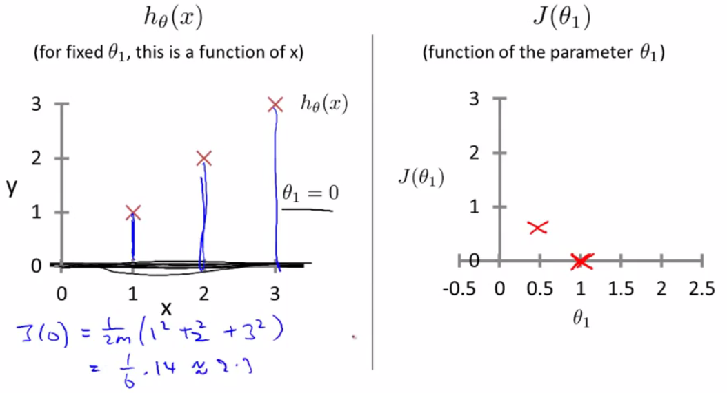

Slide 25
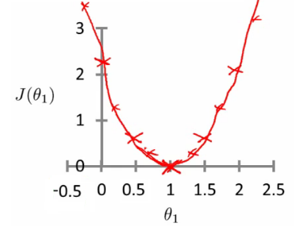
If we compute a range of values plot
J(θ₁) vs θ₁ we get a polynomial (looks like a quadratic)
The optimization objective for the learning algorithm is find the value of θ₁ which minimizes J(θ₁)
So, here θ₁ = 1 is the best value for θ₁

Slide 26
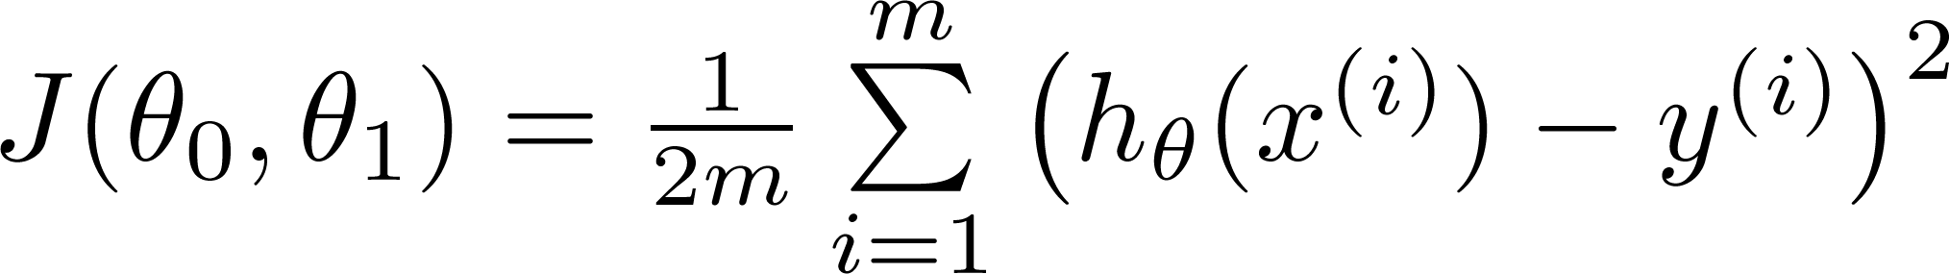
Hypothesis:
Parameters:
Cost Function:
Goal:

Slide 27
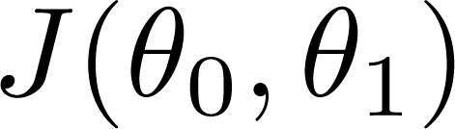


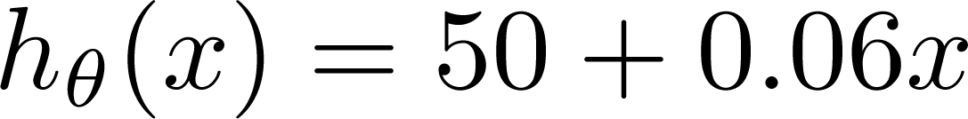
(for fixed , this is a function of x)
(function of the parameters )
Price ($)
in 1000’s
Size in feet² (x)

Slide 28
Previously we plotted our cost function by plotting
θ₁ vs J(θ₁)
Now we have two parameters
Plot becomes a bit more complicated
Generates a 3D surface plot where axis are
X = θ₁
Z = θ₀
Y = J(θ₀,θ₁)

Slide 29
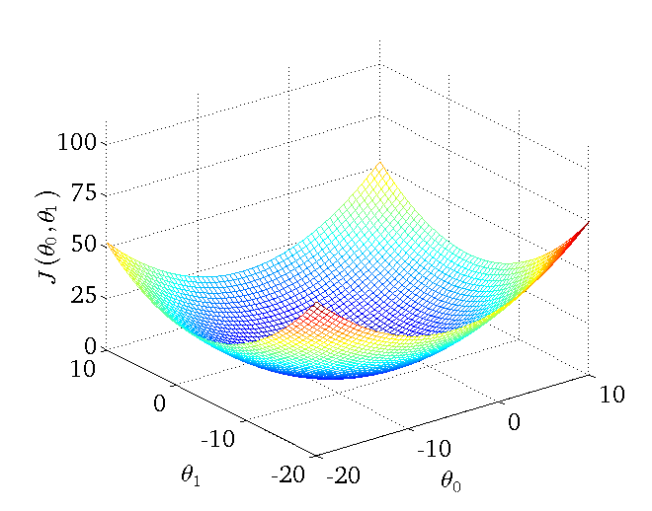
We can see that the height (y) indicates the value of the cost function, so find where y is at a minimum

Slide 30
Gradient descent
Linear regression with one variable
Machine Learning

Slide 31
Minimize cost function J
Gradient descent
Used all over machine learning for minimization
Start by looking at a general J() function
Problem
We have J(θ₀, θ₁)
We want to get min J(θ₀, θ₁)

Slide 32
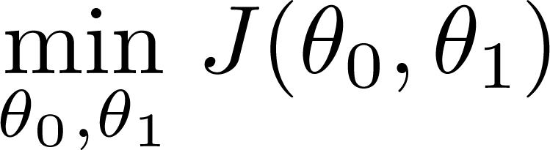
Have some function
Gradient descent applies to more general functions
J(θ₀, θ₁, θ₂ .... θ_{n})
min J(θ₀, θ₁, θ₂ .... θ_{n})
Want
Outline:
Start with some
Keep changing to reduce until we hopefully end up at a minimum

Slide 33
Start with initial guesses
Start at 0,0 (or any other value)
Keeping changing θ₀ and θ₁ a little bit to try and reduce J(θ₀,θ₁)
Each time you change the parameters, you select the gradient which reduces J(θ₀,θ₁) the most possible
Repeat
Do so until you converge to a local minimum
Has an interesting property
Where you start can determine which minimum you end up
Here we can see one initialization point led to one local minimum
The other led to a different one

Slide 34
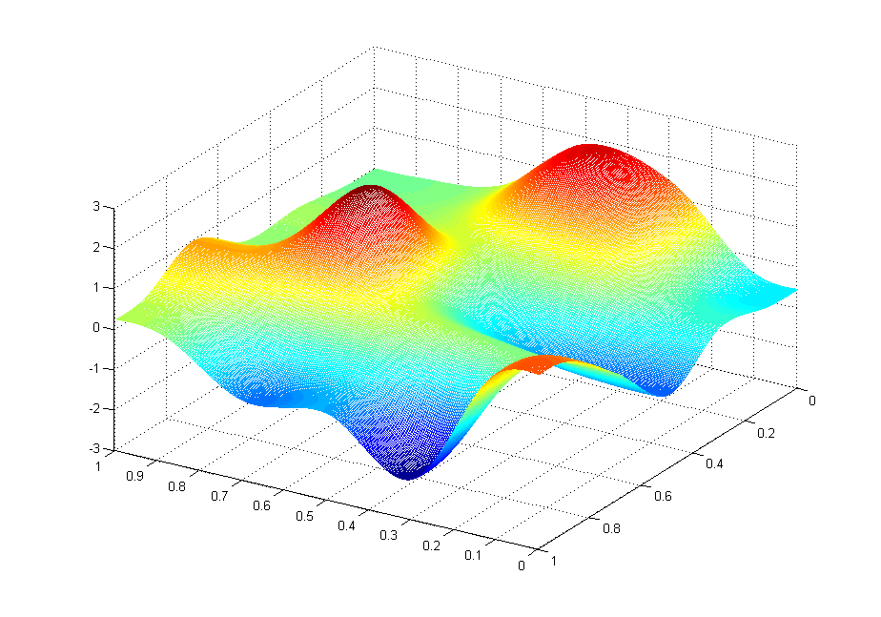
J(θ₀,θ₁)
θ₁
θ₀

Slide 35
J(θ₀,θ₁)
θ₁
θ₀

Slide 36
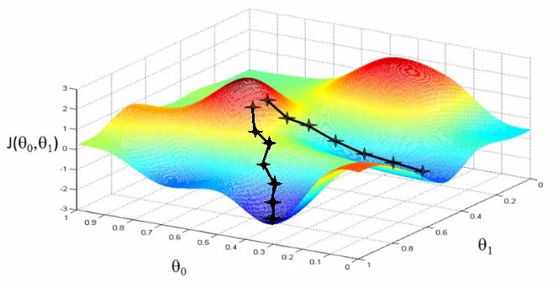

Slide 37
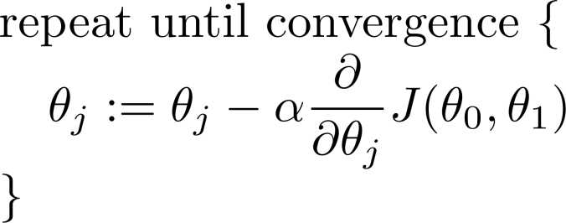
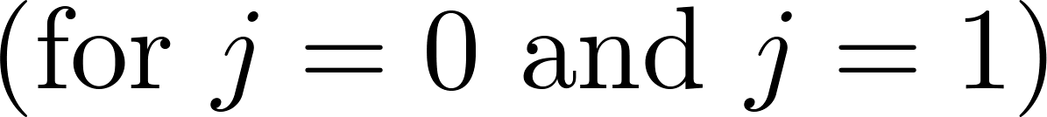
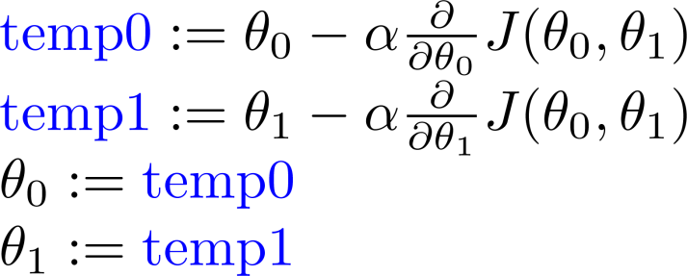
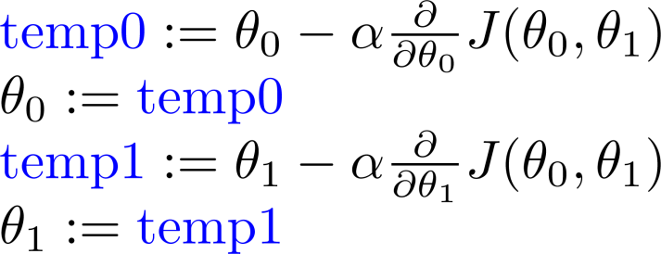
Gradient descent algorithm
Correct: Simultaneous update
Incorrect:

Slide 38
Notation:=
Denotes assignment
NB a = b is a truth assertion
α (alpha)
Is a number called the learning rate
Controls how big a step you take
If α is big have an aggressive gradient descent
If α is small take tiny steps

Slide 39
Gradient descent intuition
Linear regression with one variable
Machine Learning

Slide 40
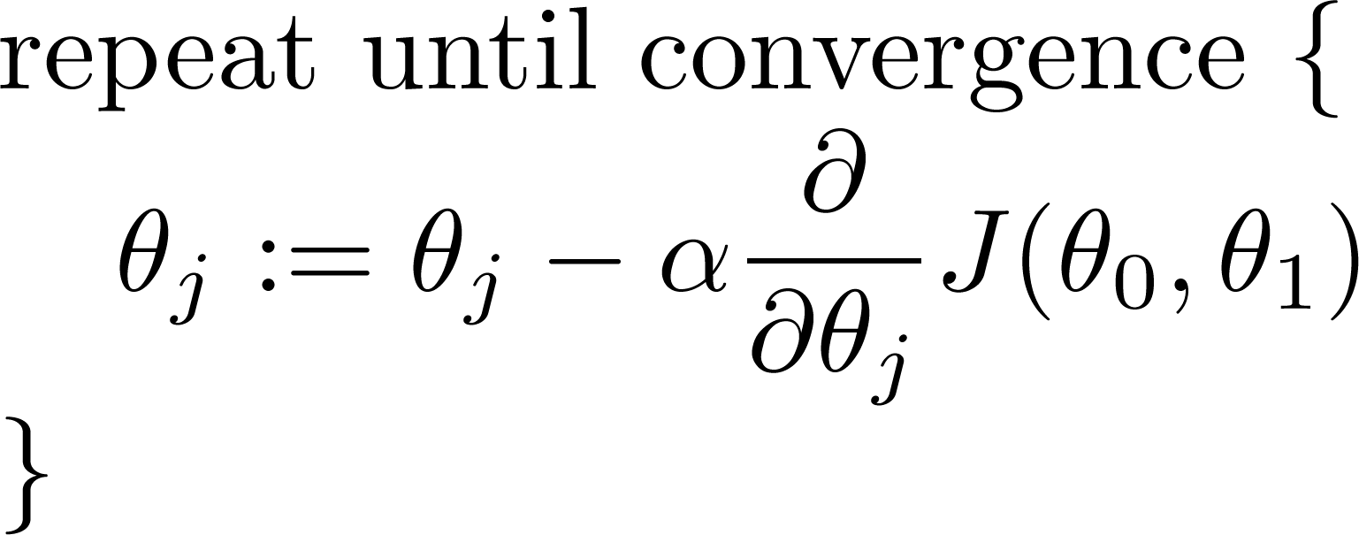
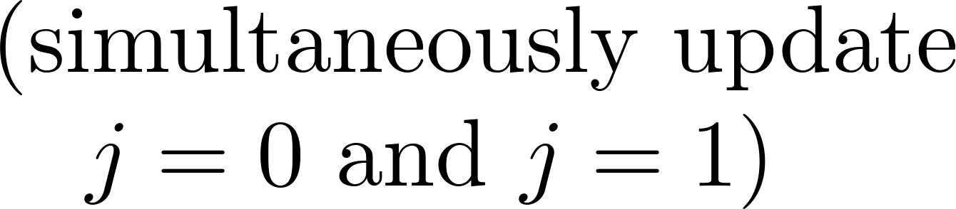
Gradient descent algorithm
To understand gradient descent, we'll return to a simpler function where we minimize one parameter to help explain the algorithm in more detail.
min θ₁ J(θ₁) where θ₁ is a real number

Slide 41
Notation nuances
Partial derivative vs. derivative
Use partial derivative when we have multiple variables but only derive with respect to one
Use derivative when we are deriving with respect to all the variables

Slide 42
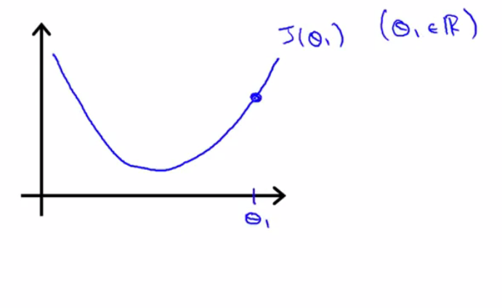

Slide 43
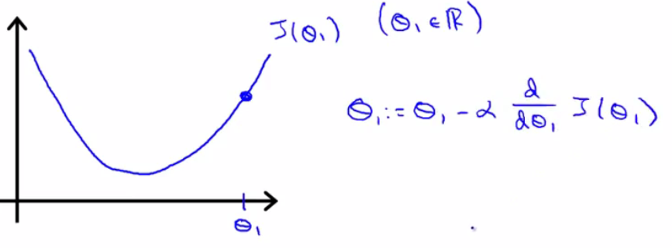

Slide 44
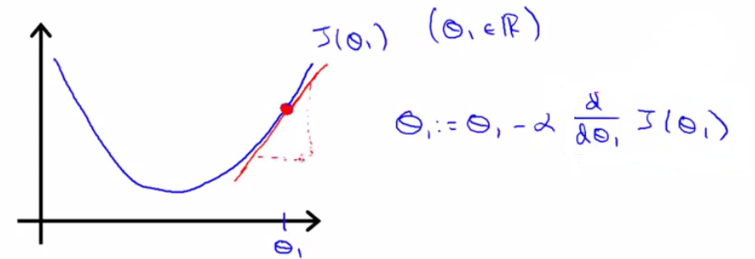

Slide 45
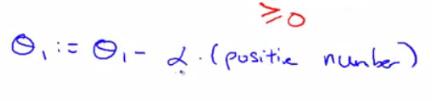

Slide 46
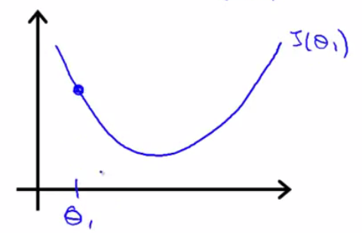

Slide 47
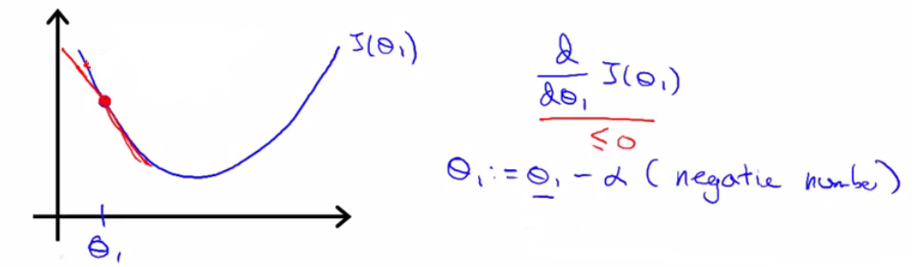

Slide 48
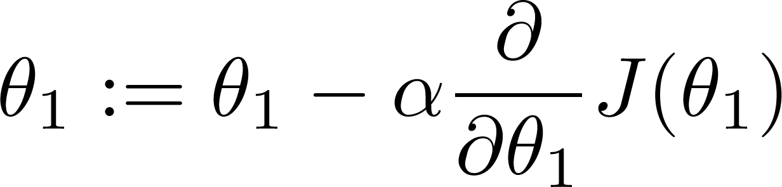
If α is too small, gradient descent can be slow.
If α is too large, gradient descent can overshoot the minimum. It may fail to converge, or even diverge.

Slide 49
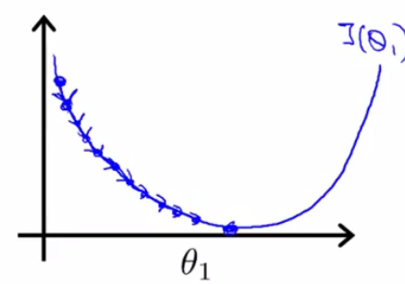
If α is too small, gradient descent can be slow.
If α is too large, gradient descent can overshoot the minimum. It may fail to converge, or even diverge.

Slide 50
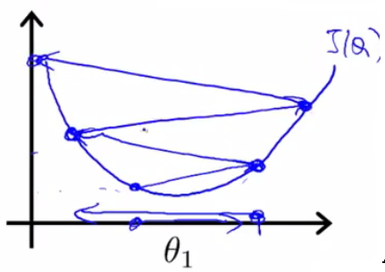
If α is too small, gradient descent can be slow.
If α is too large, gradient descent can overshoot the minimum. It may fail to converge, or even diverge.

Slide 51

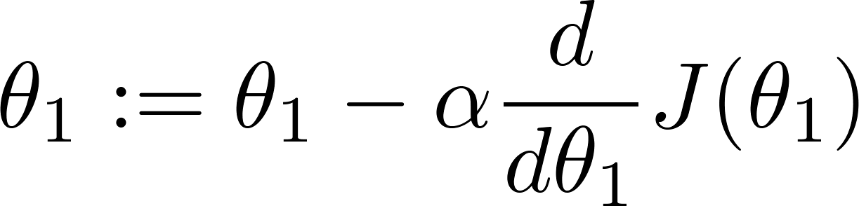
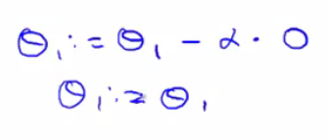
at local optima
Current value of

Slide 52
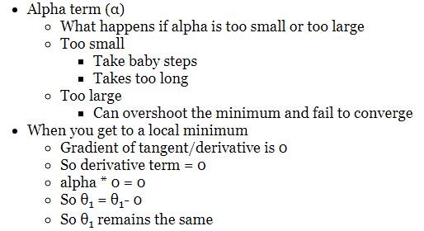

Slide 53
Gradient descent can converge to a local minimum, even with the learning rate α fixed.
As we approach a local minimum, gradient descent will automatically take smaller steps. So, no need to decrease α over time.

Slide 54
As you approach the global minimum the derivative term gets smaller, so your update gets smaller, even with alpha is fixed
Means as the algorithm runs you take smaller steps as you approach the minimum
So no need to change alpha over time

Slide 55
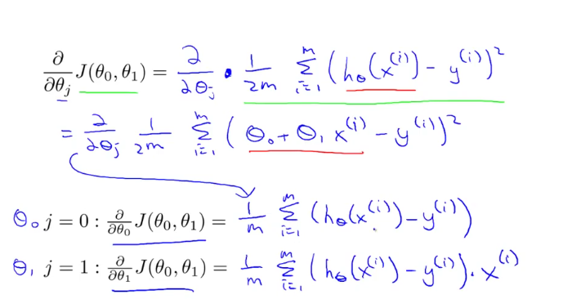
Partial Derivative:

Slide 56
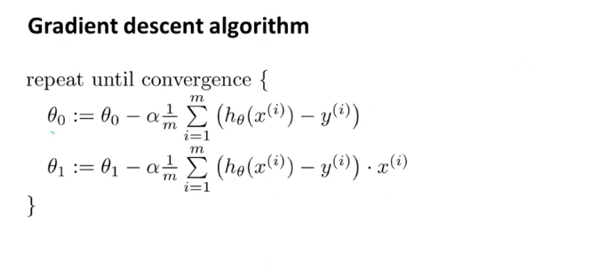

Slide 57
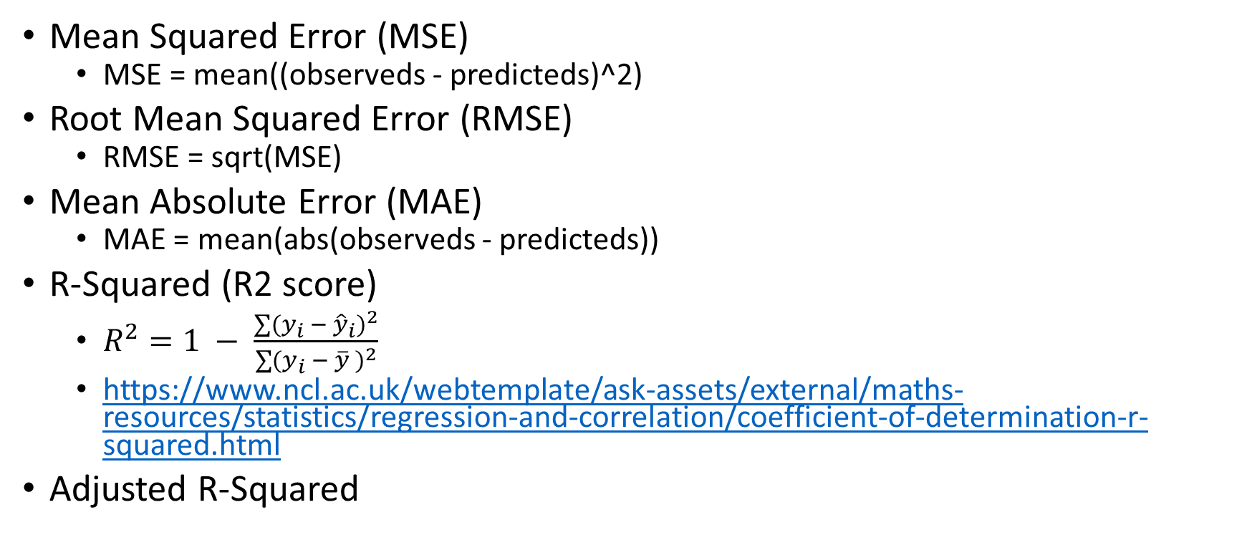
Performance Metric
Mean Squared Error (MSE)
MSE = mean((observeds - predicteds)^2)
Root Mean Squared Error (RMSE)
RMSE = sqrt(MSE)
Mean Absolute Error (MAE)
MAE = mean(abs(observeds - predicteds))
R-Squared (R2 score)
$R^{2}=1 − \frac{\sum{(y_{i} − {\hat{y}}_{i})^{2}}}{\sum{(y_{i}} − \overline{y} )^{2}}$
https://www.ncl.ac.uk/webtemplate/ask-assets/external/maths-resources/statistics/regression-and-correlation/coefficient-of-determination-r-squared.html
Adjusted R-Squared

